Slide 1
Air Interfaces & RF Transmission
Technologies and Risks
The increase in performance of 5G is based on New Radio (NR) and a number of key technologies including Massive MIMO and Beamforming, and the use of OFDM, a highly spectral-efficient modulation technique, and mmWave spectrum.

Slide 2
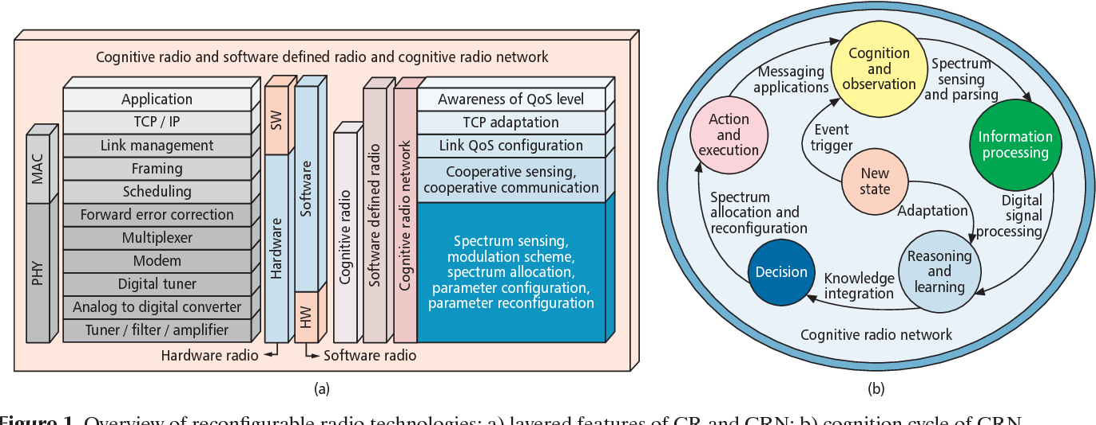
Cognitive Radio
Cognitive radio network (CRN) offers dynamic spectrum sharing to achieve higher spectrum efficiencies as required in 5G architecture.
Cognitive radio technology improves the utilization of the radio electromagnetic spectrum. A cognitive radio is a smart device which runs radio applications software to perform signal processing. This enables the device to sense and understand its environment and actively change its mode of operation based on its observations.

Slide 3
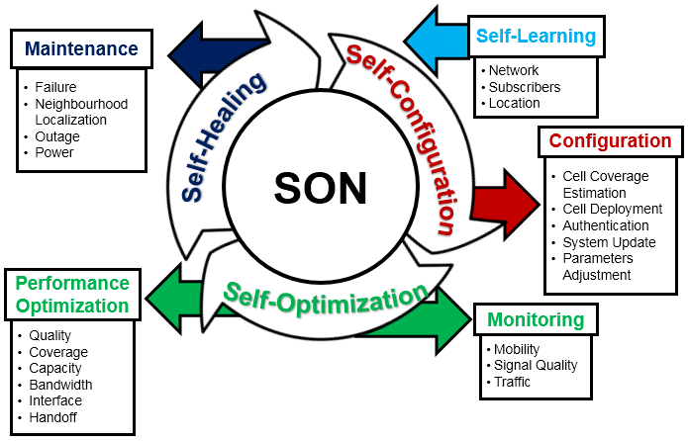
Self Organising Networks
Self-organizing networks are radio access networks (RANs) that automatically plan, configure, manage, optimize, and heal themselves.
SONs can offer automated functions such as self-configuration, self-optimization, self-healing, and self-protection.
There are two main aspects of the cognitive network.
Zero-touch deployment and operation:
Networks are deployed and adapted dynamically. Zero-touch means that once a service is defined, all the stages of its life cycle will be managed automatically.
Continuous real time performance improvements:
Some services have extreme performance requirements and need to be carefully tuned, optimized, and overall network performance improved based on performance measurements.

Slide 4
Major Threats to 5G-NR
Primary User Emulation Attack (PUEA)
Objective Function Attack (OFA)
Jamming Attack
Cross- layer Attack
Spectrum Sensing Data Falsification Attack (SSDF)
Control Channel Saturation DoS Attack (CCSD)
Sinkhole Attack
Hello Flood Attack
Lion Attack

Slide 5
(M)MIMO
MIMO and Massive MIMO in 5G-NR

Slide 6
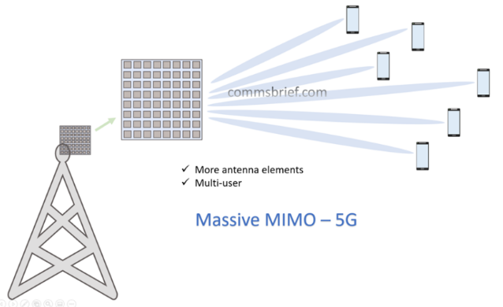
5G NR - MIMO and Massive MIMO
MIMO stands for Multiple-input multiple-output. While it involves multiple technologies, MIMO can essentially be boiled down to this single principle: a wireless network that allows the transmitting and receiving of more than one data signal simultaneously over the same radio channel. Standard MIMO networks tend to use two or four antennas.
Massive MIMO is a MIMO system with an especially high number of antennas. It employs tens or even hundreds of antenna elements within a single antenna panel. A 64 x 64 Massive MIMO antenna configuration is already used by some 5G network vendors, but 256 x 256 and beyond is also possible.
Ericsson’s AIR 6468, which the company claims is "the world's first 5G NR radio", uses 64 transmit and 64 receive antennas.
Recent iPhones in the iPhone 13 family, Android phones like the Samsung Galaxy S21 range, the Google Pixel 6, the OnePlus 9. Oppo Find X3 Pro and the Xiaomi Mi 11 support various MIMO antenna configurations.

Slide 7
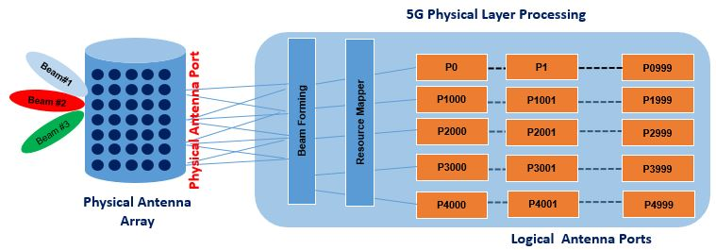
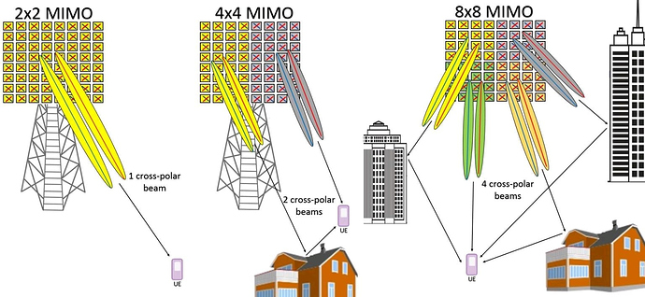
MIMO
Multiple-input, multiple-output is a radio antenna technology which deploys multiple antennas at both the transmitter and receiver to increase the quality, throughput, and capacity of the radio link. MIMO uses techniques known as spatial diversity and spatial multiplexing to transmit independent and separately encoded data signals, known as "streams", reusing the same time period and frequency resource.
MU-MIMO
In multi-user MIMO, the transmitter simultaneously sends different streams to different users using the same time and frequency resource, thereby increasing the network capacity. Spectral efficiency and capacity can be improved by adding additional antennae to support more streams, up to the point where power sharing and interference between users result in diminishing gains and, eventually, losses.

Slide 8
Spatial Multiplexing And Multi-User Support
Spatial multiplexing is one of the most important features in MIMO systems used for improving the efficiency of the frequency channel. The overall data stream intended for a specific user can be sent over multiple individual data streams. This improvement in spectral efficiency leads to higher overall capacity and, therefore, higher data rates.
Three-Dimensional (3D) Beamforming
Beamforming takes place when the signal transmission through multiple antenna elements is targeted in a particular direction instead of broadcasting the signal in all directions. Beamforming points the different beams of the signal in the desired direction. In Massive MIMO, beamforming is three dimensional, so the beams can be horizontal and vertical to improve the data rates for all users.
Transmitter And Receiver Diversity
Diversity is when multiple antennas are deployed at the transmitter or the receiver end to reduce the impact of signal fading. However, it does not improve the radio channel capacity, so the data rate or throughput is not impacted by diversity.

Slide 9
Technology |  | Threat | Mitigations | # | Control
Massive MIMO | Privacy | Pilot Contamination Attack | 10 | 1 | TAS - ML (Transmit Antenna Selection - Machine Learning)
 |  | Information Leakage | 2, 6, 7
 |  | Eavesdropping | 1, 2, 4, 7, 9 | 2 | Beamforming
 |  | Spoofing Attack | 3, 4 | 3 | Game Theoretic Study
 |  | Location Privacy | 9 | 4 | HET C-RAN (H-CRAN)
 |  | Phishing Attack | 6, 7 | 5 | Amplitude Forwarding (AF) Relaying
 | Authentication | Pilot Contamination Attack | 10 | 6 | Beamforming & AM
 |  | Eavesdropping | 1, 2, 4, 7, 9 | 7 | Linear Precoding & AM
 |  | Spoofing Attack | 3, 4 | 8 | Physical Layer(PL)-Cryptography
 |  | Active Pilot Spoofing Attack | 5, 10 | 9 | MRC-MIMO Relay System
 | Confidentiality | Pilot Contamination Attack | 10 | 10 | Sub-Space Estimation Approach, Pilot Based Estimation Approach
 |  | Information Leakage | 2, 6, 7
 |  | Jamming Attack, DOS, DDOS | 2, 6, 7 | 11 | Location Distinction
 |  | Location Privacy | 9
 |  | Computational Attack, PT Attack, Cybertext Attack | 8
 | Integrity | Eavesdropping | 1, 2, 4, 7, 9
 |  | Impersonation | 11
 |  | Computational Attack, PT Attack, Cybertext Attack | 8
 |  | Packet Injection & Modification Attack | 8
 |  | Malware Attack | 2, 6, 8
 | Reliability | Eavesdropping | 1, 2, 4, 7, 9
 |  | Location Privacy | 9
 |  | Computational Attack, PT Attack, Cybertext Attack | 8

Slide 10
D2D
Device to Device

Slide 11
Direct Device-to-Device; D2D
Device to Device (D2D) communications is the technology that allows user data to be transmitted directly between terminal devices without the need of routing through the eNBs/gNBs of the 5G host network.
In device to device applications, the user data is transferred through the terminals directly, without routing through the entire mobile network. D2D communication enables seamless communication for cellular terminals allowing the creation of ad hoc networks.
D2D techniques
D2D discovery: this includes the detection of D2D terminals at close range. This technique should be considered in conjunction with routing to meet the needs of 5G specific scenarios.
Wireless resource management: Communication using D2D can be implemented with multicast and unicast broadcast. However, programming a 5G network is more complicated than other networks.
Interference control: interference will be handled by offloading the 5G network and using advanced compensation techniques.
Mode change communication: It involves switching between D2D and cellular functions. This will result in extra flexibility and the corresponding system stability.

Slide 12
Device to Device
Due to the increasing data traffic in mobile network, fifth generation (5G) will use Device to Device (D2D) communications as the underlay technology to offload traffic from the 5G core network (5GC) and push content to the edge closer to the users by taking advantage of proximity and storage features of User Equipment (UE).
This will be supported by Networks Services (NS) provided by 5G.
It will also enable new use cases that will provide the accessibility to other services in the Home network (HN) and third-party service provider (SP).
Mobile Network Operators (MNO) will use NS such as D2D communications and content-centric networking (CCN) to deliver content-based services efficiently to UE.
Both D2D and CCN have known security issues and their integration brings new security challenges.

Slide 13
Some Key Components of D2D
Main Types:
InBand D2D Communication :
In this type, both cellular communication and D2D use same licensed spectrum.
OutBand D2D Communication :
In this type, D2D uses unlicensed spectrum (2.4 GHz ISM band or 38 GHz mmwave band) where as cellular uses licensed spectrum as given by network operator.
Main Subtypes;
Underlay D2D communication
In this subtype, licensed spectrum is not divided for D2D and Cellular use.
Overlay D2D communication
In this subtype, licensed spectrum is divided into non-overlapping parts for D2D and cellular links.

Slide 14
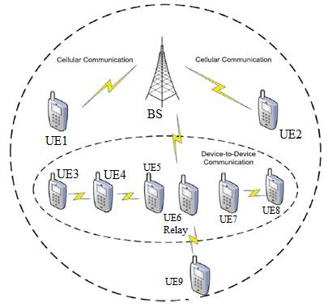
D2D Schematic
Example;
Android UE
Mobile Hotspot and Tethering

Slide 15
D2D Security Considerations
 | Technology |  | Threat | Mitigations | # | Control Name
D2D | Inband | Underlay | Malware | 1, 2, 3 | 1 | Access Control
 | Outband | Overlay | Interference | 4, 5 | 2 | Confidentiality
 |  | Controlled | Eavesdropping | 6, 11 | 3 | Integrity
 |  | Autonomous | Session hijacking | 6, 11 | 4 | Obfuscation
 |  |  | Man in the middle | 6 | 5 | Anonymity
 |  |  | Impersonation | 7, 8, 9 | 6 | Cryptology
 |  |  | Masquerading | 7, 8, 9 | 7 | Key Management
 |  |  | DDOS | 10 | 8 | Authentication
 |  |  | IP spoofing | 11, 12 | 9 | Authorization
 |  |  | Bandwidth spoofing | 11 | 10 | Availability & Dependability
 |  |  | Location spoofing | 4, 5 | 11 | Secure Tx routing
 |  |  | Jamming attack | 10 | 12 | Intrusion protection

Slide 16
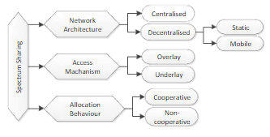
Spectrum Sharing
Spectrum sharing is the simultaneous usage of a specific radio frequency band in a specific geographical area by a number of independent entities.
Simply, it is the “cooperative use of common spectrum” by multiple users. Spectrum sharing also can take many forms, coordinated and uncoordinated.
Dynamic Spectrum Sharing (DSS) is a new antenna technology that for the first time enables the parallel use of LTE and 5G in the same frequency band. The technology determines the demand for 5G and LTE in real-time.

Slide 17
Technology | Technology | Threat | Mitigations | # | Control
Spectrum Sharing | Physical Layer | Spectrum Sensing Data Falsification | 1, 2, 3, 4 | 1 | Signal Superposition
 |  | Primary User Impersonation | 1, 2, 3, 4 | 2 | Radio Signal Fingerprinting
 | Data Link Layer (MAC) | Rogue Transmitter (DOS) | 5, 6, 7, 8 | 3 | ElectroMagnetic (EM) Signature Identification
 |  | Beacon Falsification | 5, 6, 7, 8 | 4 | Signal Watermarking
 |  | Lion Attack | 9, 10, 11, 12 | 5 | Intrusion Protection System
 | Primary System | Confidentiality | 9, 10, 11, 12 | 6 | Manipulation in Software Defined Radio (SDR) and Cognitive Radio (CR)
 |  | Database Interference | 9, 10, 11, 12 | 7 | Policy Enabled Cognitive Radio
 | Secondary System | Location Privacy | 9, 10, 11, 12 | 8 | Rules Based Policy Reasoner
 |  |  |  | 9 | Tamper Resistance
 |  |  |  | 10 | Legal Action
 |  |  |  | 11 | Spectrum inaccesible to rogue transmitter
 |  |  |  | 12 | Check Received Signal Strength for False Transmitter

Slide 18
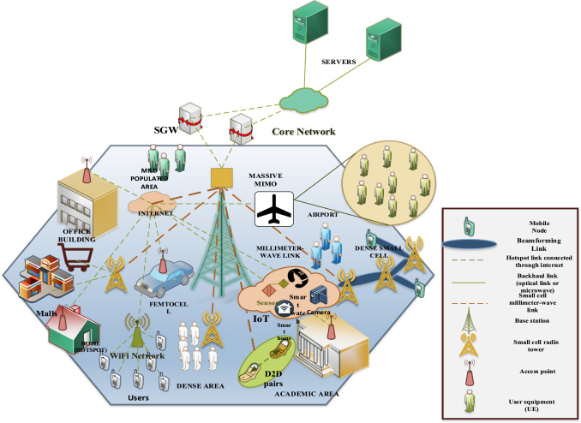
Ultra Dense Networks
The Ultra Dense Network (UDN) is a technology in 5G to address the network system capacity issue. It can enhance spatial reuse through the flexible, intensive deployment of small base stations. A universal 5G UDN architecture is necessary to realize the autonomous and dynamic deployment of small base stations.
Security Challenges in UDN
Access Authentication Security for UE to UDN.
Communication Security among APs/APG
Communication Security between UE and AP/APG
Communication Security between AP/APG and Network
One type of UDN is based on the static virtual cell, which is composed of multiple access points in the area to form a “large” static cell and can provide users a similar coverage to that of the macro base station service experience with a unified identity and common services.
Another type of UDN is the user-centric UDN (UUDN), which has a local control center coordinated with the user, and the virtual adjoined cell is defined based on the unit of a single user.

Slide 19
Technology |  | Threat | Mitigations |  | Control
Ultra Dense Networks | Physical Layer | Spectrum Sensing Data Falsification | 1, 2, 3, 4 | 1 | Signal Superposition
 |  | Primary User Impersonation | 1, 2, 3, 4 | 2 | Radio Signal Fingerprinting
 | Data Link Layer (MAC) | Rogue Transmitter (DOS) | 5, 6, 7, 8 | 3 | ElectroMagnetic EM Signature Identification
 |  | Beacon Falsification | 5, 6, 7, 8 | 4 | Watermarking
 |  | Lion Attack | 9, 10, 11, 12 | 5 | Intrusion Protection System
 | Primary System | Confidentiality | 9, 10, 11, 12 | 6 | Manipulation in Software Defined Radio and CR Cognitive Radio
 |  | Database Interference | 9, 10, 11, 12 | 7 | Policy Enabled CR
 | Secondary System | Location Privacy | 9, 10, 11, 12 | 8 | Rules Based Policy Reasoner
 |  |  |  | 9 | Tamper Resistance
 |  |  |  | 10 | Legal Action
 |  |  |  | 11 | Spectrum inaccesible to rogue transmitter
 |  |  |  | 12 | Check Received Signal Strength for False Transmitter

Slide 20
IoT
Internet of Things over 5G-NR

Slide 21
5G cellular networks are designed to address the need for increased bandwidth of;
eMBB – enhanced mobile broadband for end user services,
URLLC – ultra-reliability and low-latency of critical industrial use cases,
mMTC – long-range, low-power connectivity of massive machine-type IoT applications.
To meet such contrasting requirements, 5G networks rely on its new radio interface (5G-NR) to address eMBB and URLLC services
Other IoT Considerations
NB-IoT
Narrowband Internet of things is a low-power wide-area network (LPWAN) radio technology standard developed by 3GPP for cellular devices and services.
LPWAN
A low-power wide-area network (LPWAN) or low-power wide-area (LPWA) network or low-power network (LPN) is a type of wireless telecommunication wide area network designed to allow long range communications at a low bit rate among IoT things (connected objects), such as sensors operated on a battery.
LPWANs can accommodate packet sizes from 10 to 1,000 bytes at uplink speeds up to 200 Kbps. LPWAN's long range varies from 2 km to 1,000 km, depending on the technology. Most LPWANs have a star topology where, similar to Wi-Fi, each endpoint connects directly to common central access points
( LoRaWAN standards are one of the leading open standards for IoT across the globe, using public, private, and hybrid networks for LPWAN, these are developed by the LoRa Alliance. )

Slide 22
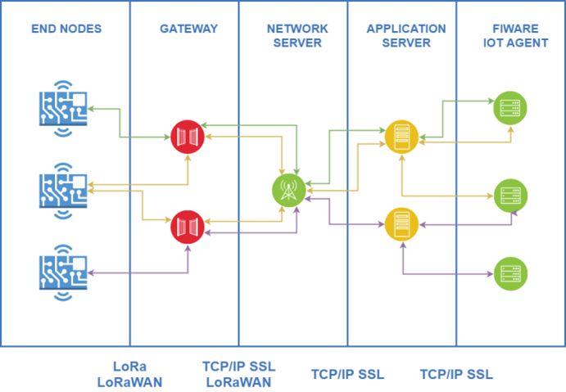
LoRaWAN
Not suited for large data payloads, payload limited to 100 bytes. Not for continuous monitoring (except Class C devices). Not ideal for real time applications requiring lower latency and bounded jitter requirements.
Security is a primary concern for any mass IoT deployment and the LoRaWAN specification defines two layers of cryptography:
A unique 128-bit Network Session Key shared between the end-device and network server
A unique 128-bit Application Session Key (AppSKey) shared end-to-end at the application level
AES algorithms are used to provide authentication and integrity of packets to the network server and end-to-end encryption to the application server. By providing these two levels, it becomes possible to implement ‘multi-tenant’ shared networks without the network operator having visibility of the users payload data.
The keys can be Activated By Personalisation (ABP) on the production line or during commissioning, or can be Over-The-Air Activated (OTAA) in the field. OTAA allows devices to be re-keyed if necessary.
The backend interfaces involve control and data signaling among network and application servers.
HTTPS and VPN technologies are used for securing the communication among these critical infrastructure elements

Slide 23
Technology |  |  | Threat | Mitigations | # | Control
IoT |  | Edge Computing | Side Channel Attack | 1, 2, 4, 8 | 1 | Isolation
 |  |  | Integrity Attack | 13 | 2 | Kill/Sleep Command
 |  |  | Logging Insufficient/Inessential | 15 | 3 | Anonymous Tag
 |  |  | Malicious Injection | 15 | 4 | Blocking
 |  |  | Causative Attack | 15 | 5 | Firewall
 |  | Communications Links | Denail of Service | 5, 11, 16 | 6 | Information Flooding
 |  |  | Side Channel Attack | 1, 2, 4, 8 | 7 | Distance Estimation
 |  |  | Impersonation | 11, 16 | 8 | Secure Firmware Update
 |  |  | Unauthorised Links | 11, 16, 17 | 9 | Trojan Activation Methods
 |  |  | Routing Attacks | 18 | 10 | Side Channel Signal Analysis
 | Edge Nodes | RFID Tags | Eavesdropping | 1, 4, 5, 16 | 11 | IDS/IPS
 |  |  | Tracking | 1, 2, 3, 4, 6, 14 | 12 | Design/ Circuit Modification
 |  |  | Tag Cloning | 1, 2, 4, 16 | 13 | Outlier detection
 |  |  | Inventorying | 1,2,3,4 | 14 | De-Patterning & Decentralization
 |  |  | Counterfeiting | 2, 5, 16 | 15 | Pre-Testing
 |  | Computing Nodes | Physical attacks | 12 | 16 | PKI & Cryptographic schemes
 |  |  | Node Corruption | 8, 10, 11, 12, 16 | 17 | Role Based Authoricsation - (AAA)
 |  |  | Node Replication Attack | 16 | 18 | Reliable & Secure routing
 |  |  | Camouflage | 8, 16
 |  |  | Denail of Service | 5, 11, 16
 |  |  | Side Channel Attack | 1, 2, 4, 8

Slide 24
Radio Access Network
RAN

Slide 25
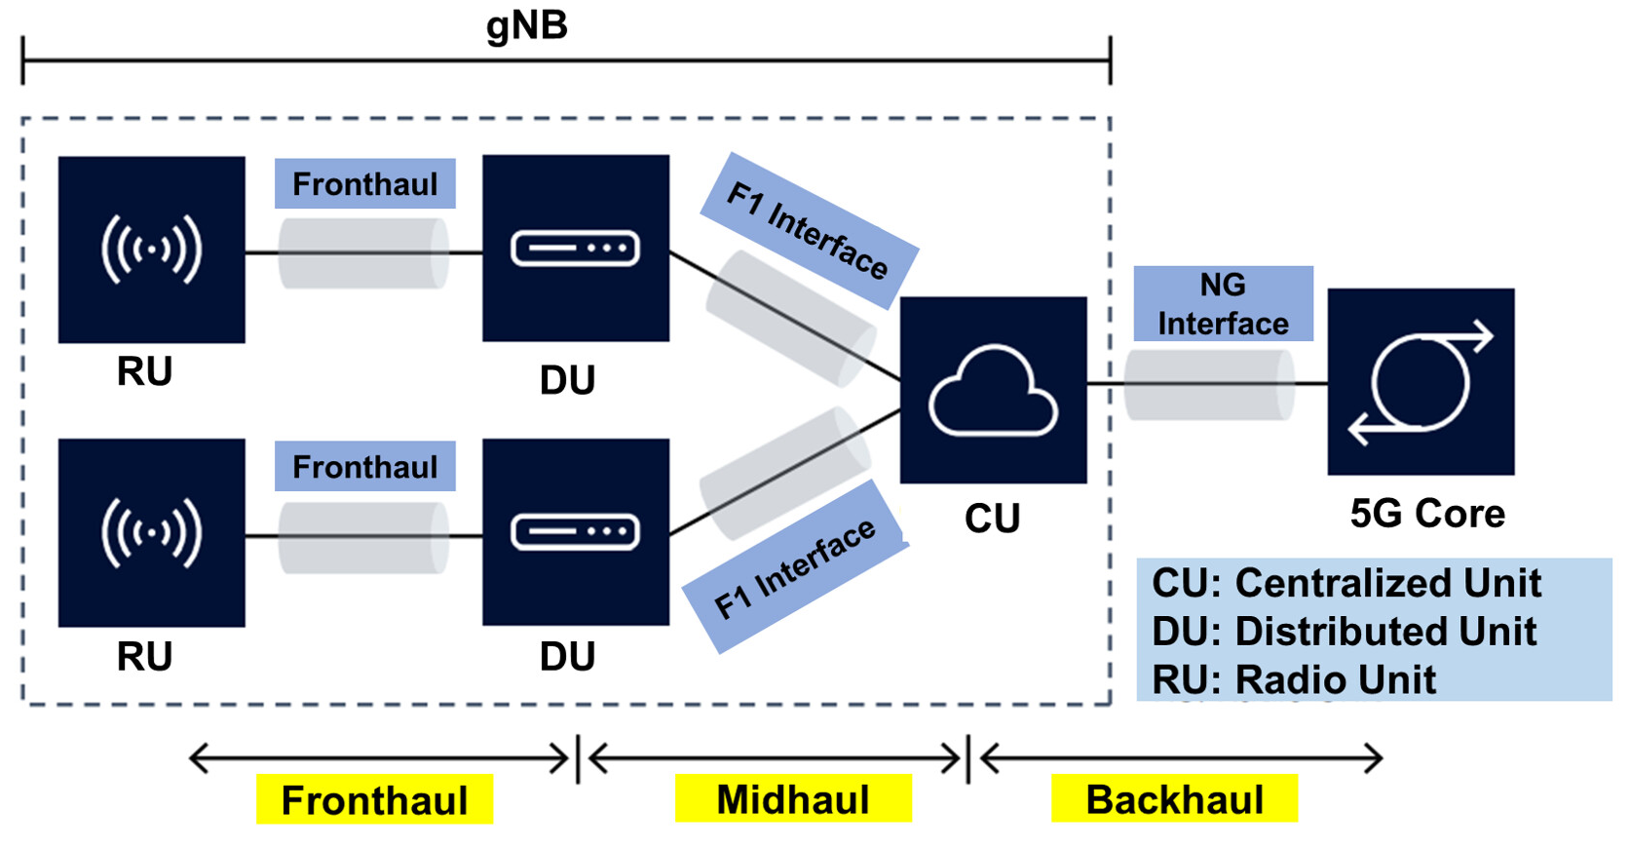
Transport : Fronthaul, Midhaul, & Backhaul
5G fronthaul facilitates enhanced mobile broadband (eMBB), ultra-reliable low-latency communications (uRLLC) and massive machine-type communication (mMTC) for internet of things (IoT) networks. 5G provides gigabit (Gb) speeds and low latency, and it helps establish fronthaul transport capacity.
What is meant by Fronthaul, Midhaul and Backhaul in 5G?
These are the links that are connecting the RU (Radio Unit), DU (Distributed Unit), CU (Centralized Unit) and the core network together;
Fronthaul refers to the link between the Radio Unit and Distributed Unit
Midhaul refers to the link between the Distributed Unit and Centralised Unit
Backhaul is representing the link between the Centralised Unit and the Core Network.
In 5G the base-station is logically split in CU and DU with a interface between them.

Slide 26
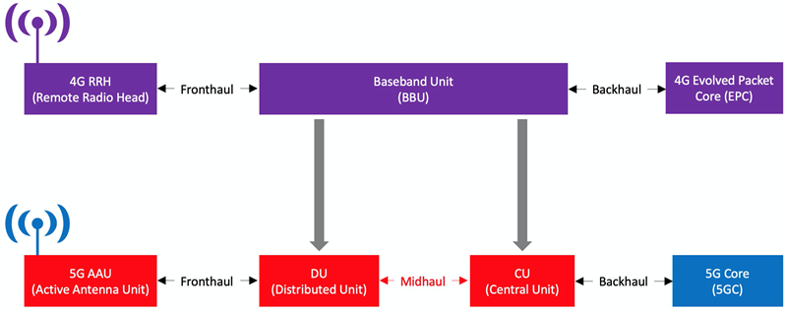
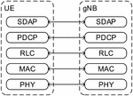
4G
Protocols
Access Management Function (AMF) serves as termination point for Non-Access Stratum (NAS) security
5G-NR
New Radio
The AUthentication Function (AUSF) keeps a key for reuse, derived after authentication

Slide 27
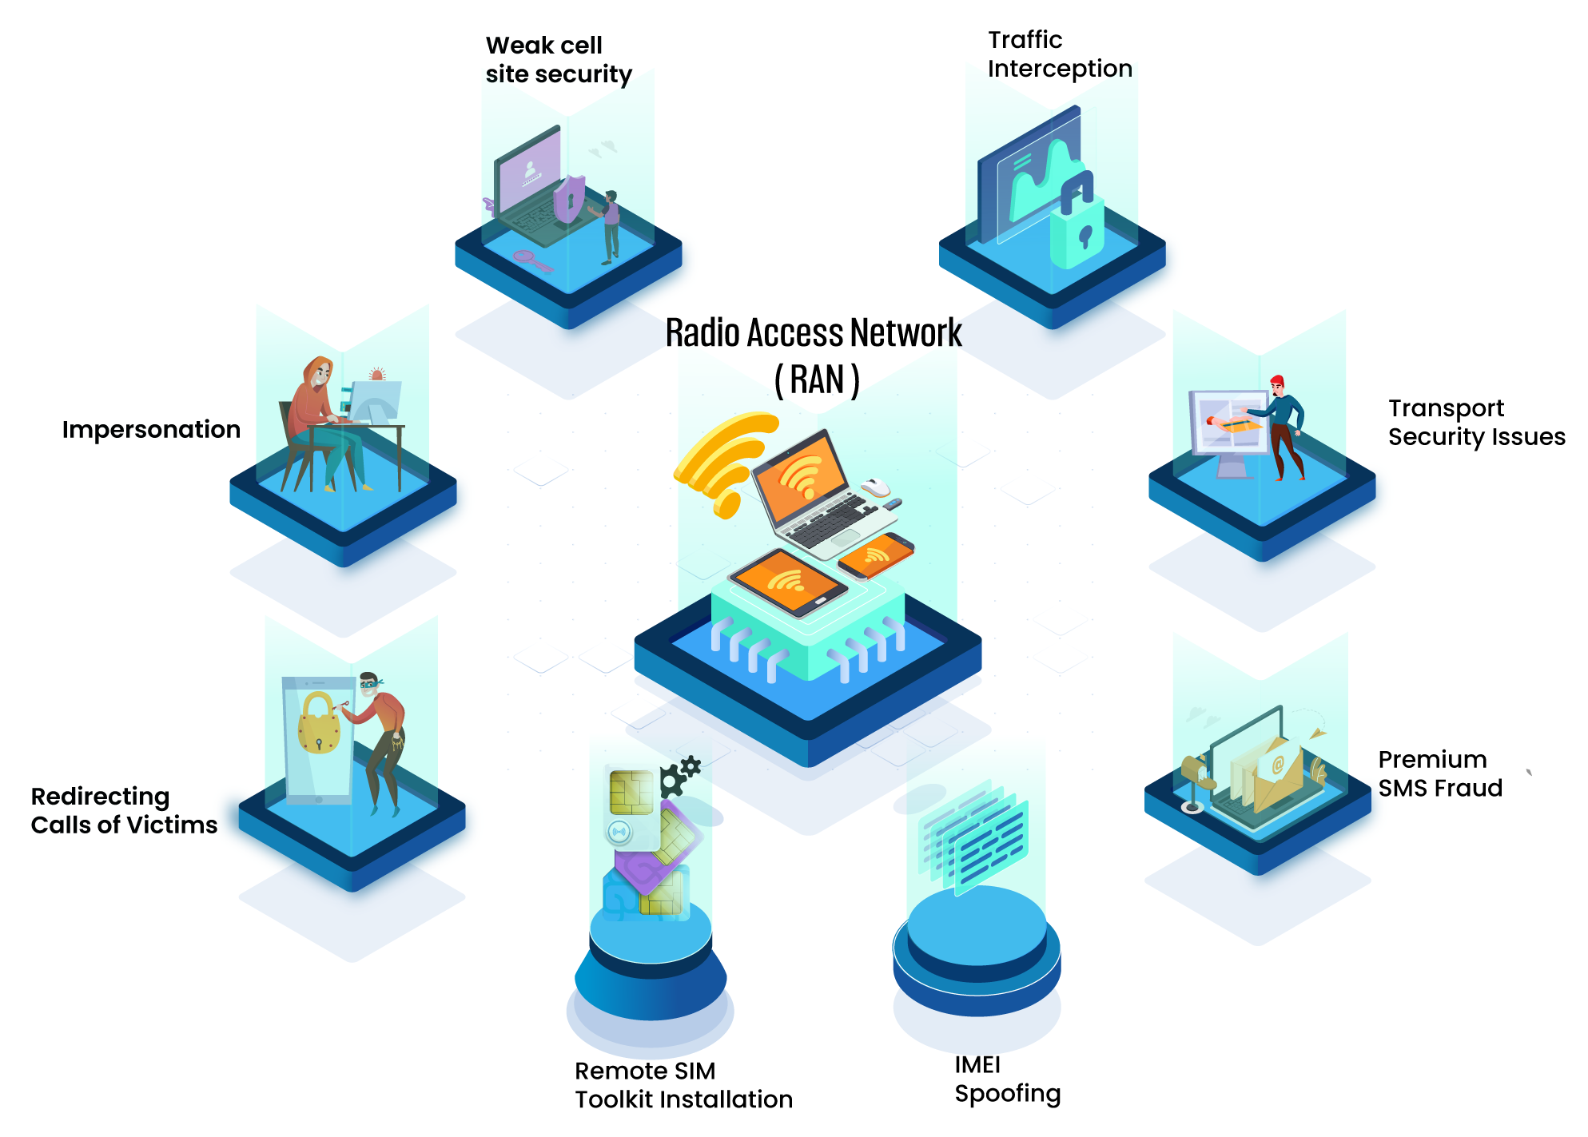

Slide 28
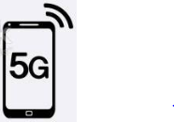

Enterprise Using Network Overlays – DNN(APN)
Corporate Users
Enterprise Network Overlays
Service Overlay (VPN/Slicing/DNN )--- Corp2.x
Service Overlay (VPN/Slicing/DNN) --- Corp1.x
Corporate/Branch Office
5G Infrastructure
IMS
Interconnect
Internet
Access Networks (RAN)
Core Network
3GPP Access(5G)
Control Plane
MPLS NSP
Non-3GPP Access(WiFi etc)
User Plane
WAN
Other SP’s
Management Plane

Slide 29
SDN, NFV and Slicing
Network slicing opens the possibilities to address the complex requirements of multi-tenancy and virtual private networks in 5G networks.
SDN, NFV and Network Slicing are new concepts and technologies that have emerged as 5G enablers. These technologies can be leveraged to provide Security as a Service (SECaaS) by deploying Security Virtualized Network Functions (VNFs) within different slices.
The proposed architecture framework aims to ensure elasticity by dynamically deploying security VNF instances, monitoring their performance, and performing predictive auto-scaling based on pre-defined policies and metrics.

Slide 30
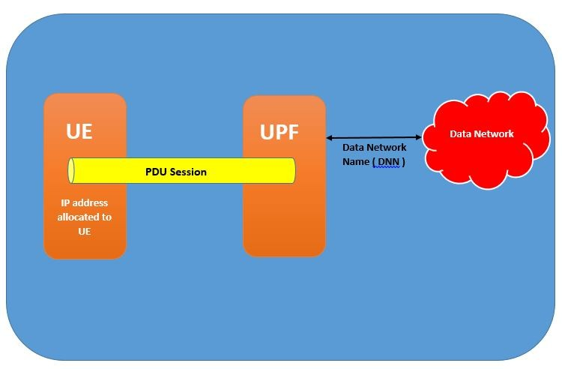
5G Data Network Name
– DNN (APN in 4G)
Each individual NPN service can be assigned specific UPF for Closed User Group (Enterprise Users) Data connectivity.
DNS returns appropriate UPF to be used
DNS
DNN Name Server

Slide 31
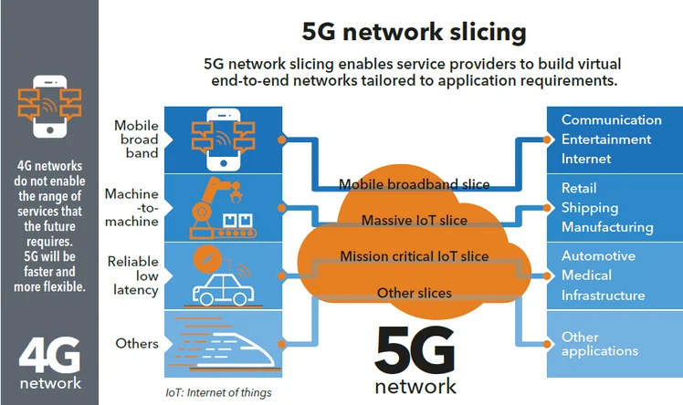
Network Slicing Technology
The simplest possible way to describe network slicing is horizontal virtualization with an approach centred around combining the following:
The 5G New Radio (NR) network
Software-Defined Networking (SDN) technology
Network functions virtualisation (NFV) architecture
These create various self-sufficient network slices facilitating segregation of users, machines, and services that demand a distinct quality of service (QoS).

Slide 32
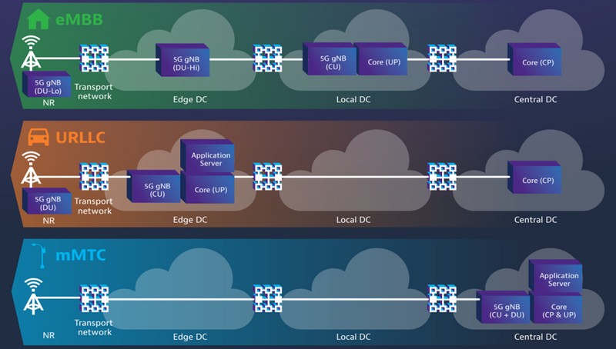
Technical View of Slicing
A Network slice is effectively a type of point to point tunnel that has a predetermined quality of service network profile suited to the needs of the service it is transporting; for instance real time data as opposed to background data.

Slide 33
Security Considerations of Network Slicing
Network slicing increases network complexity which has security implications.
Every network slice carries a different traffic Profile.
The scalability increases the potential network threats.
Protection of Data on one slice from modification by another slice on the same infrastructure.
SDN and NFV are also potential threat areas. (ie: Attackers can analyse the processing time of a packet using the SDN’s input buffer).
Security threats around NFV include attacks on the orchestration management systems, denial of service attacks etc.
Close coordination between operators and enterprises is essential to maintain secure communication across slices.

Slide 34
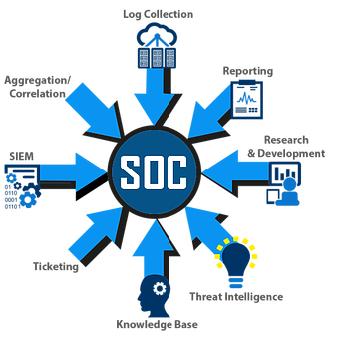
SOC Services

Slide 35
SASE –
Secure Access Service Edge
Secure Access Service Edge (SASE – Gartner 2019) is a framework that is designed to be an enabler to secure and transform the 5G ecosystem.
SASE Cloud architecture provides a single Identity-driven network that connects and secures any enterprise resource – physical, cloud, and mobile – anywhere.
SASE applies all network optimizations, security inspection, and policy enforcement with rich context before forwarding traffic onto its destination
SASE is a fundamentally different approach to the way telco services integrated bundles of point solutions.

Slide 36
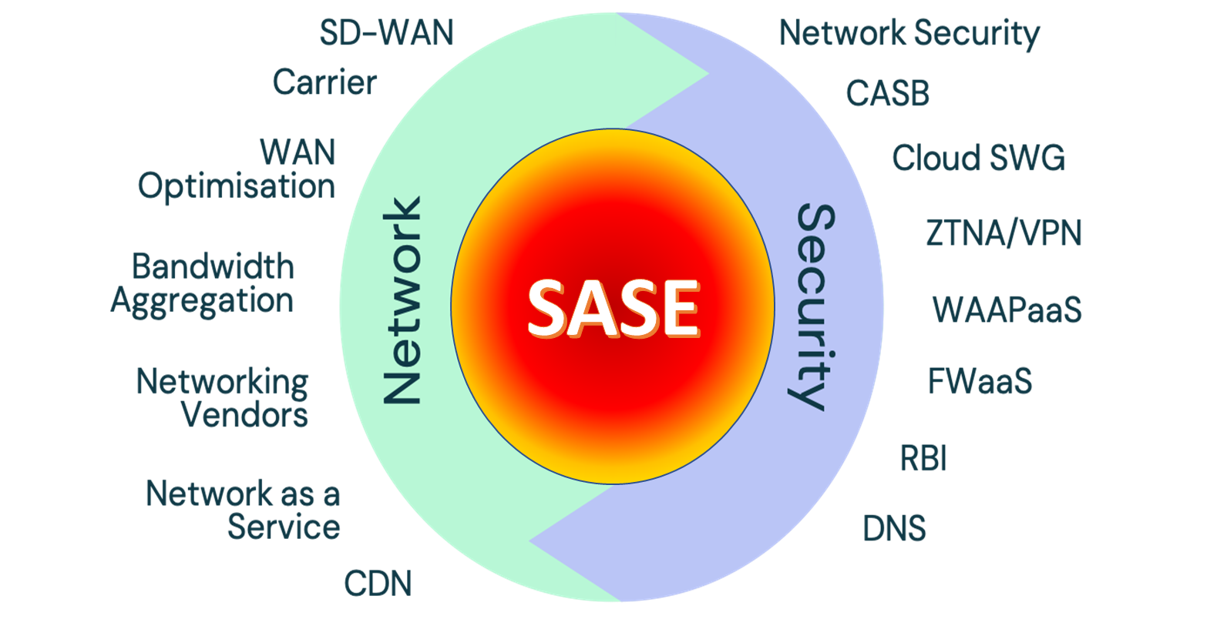
SASE Architecture
CASB – Cloud access security Brokers
Secure Web Gateway
ZTNA – Zero Trust Network Access
Web Application and API Protection
RBI – Remote Browser Isolation

